Slide 1




Relocation Analysis: From Birmingham to Bangkok

Slide 2
Relocation is not easy
Moving to a foreign country to live in a new neighborhood with different culture, lifestyles, environment, etc., while exciting, can be challenging and stressful for everyone.
I am currently in such process to relocate from Birmingham, UK to Bangkok, Thailand and would value any insights that could help me select a neighborhood in Bangkok that share some similarity to my current neighborhood – Edgbaston – and in turn lessen the challenges of living in a foreign land.
In addition to looking for similar neighborhood, I also want to maintain my current lifestyle and want the following venues within a specific radius:
Gym: within 2000 meters
Coffee Shop: within 1000 meters
Grocery Store/Supermarket: within 2000 meters
While the problem may seem to focus on my life event, the analysis is adaptable to suit anyone’s needs and should be useful for those who are moving either domestically or internationally as well.

Slide 3
Data Acquisition and Cleaning
Bangkok’s districts and coordinates were scraped from Wikipedia via the following URL: https://en.wikipedia.org/wiki/List_of_districts_of_Bangkok Only the following features from the data were kept:
District
Post Code
Latitude
Longitude
Data for my current neighborhood – Edgbaston – is provided manually but the coordinate used for the analysis was obtained using geopy package.
The cleaned data for Bangkok contains 4 features and 50 rows, while data for my neighborhood has 4 features and one row.

Slide 4
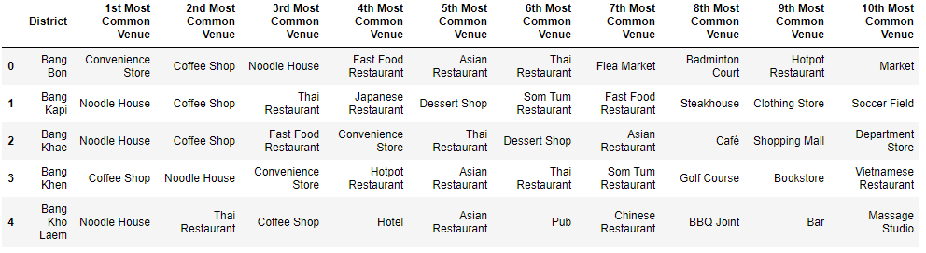
Data Acquisition – Foursquare API
Coordinates from Bangkok and my neighborhood were used to get nearby venues or point of interests from Foursquare API.
A limit is set for 100 venues, and a radius of 3,000meters from the coordinates. A wide radius was used due to my neighborhood located in a large residential area with few venues nearby, and smaller radius also seems to return very few venues for many districts in Bangkok as well.
The obtained data was cleaned and transformed to display 10 most common venues for each district.

Slide 5
Data Segregation
K-Means clustering was used as a segregation method to label district that shares similarity.
Number of clusters was set to 5. This returns a reasonable number of districts per cluster. Larger or smaller number of clusters produced results that have few clusters with most districts and most clusters with few districts or none.

Slide 6
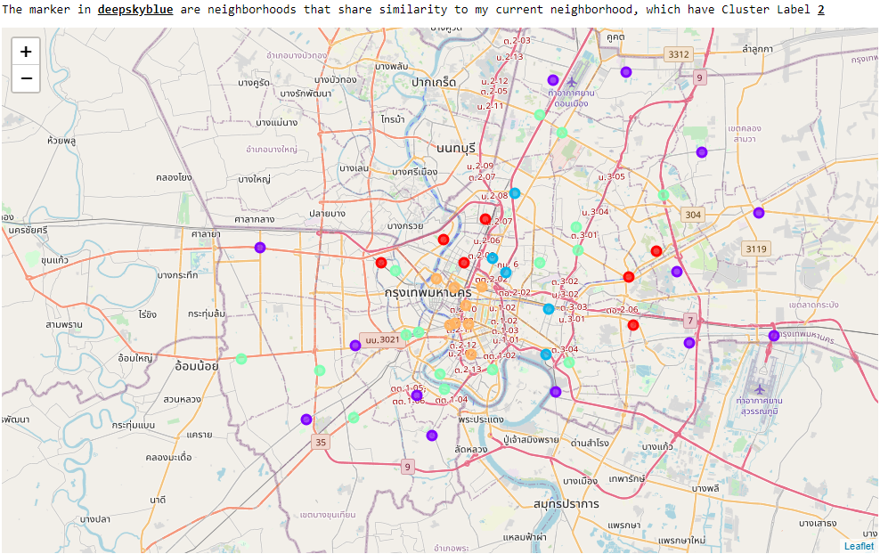
Data Visualization
A mapping package Folium was used to visualize the clustered data.
A map of Bangkok was overlaid with colored markers representing position of the district and color for each cluster label.
A printout also indicate color and label of district similar to my neighborhood.

Slide 7
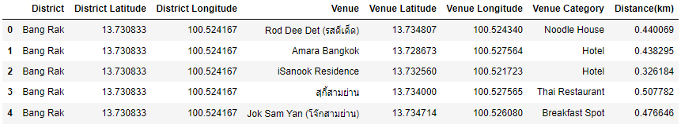
Applying Venues Requirements
Recall the requirements of venues within a distance I set at the beginning:
Gym: within 2000 meters
Coffee Shop: within 1000 meters
Grocery Store/Supermarket: within 2000 meters
Data with 10 most common venues were filtered to display only data from similar district to my neighborhood.
Distance between venues and the district was calculated using geopy.distance package and appended to the data as column ‘Distance’.

Slide 8
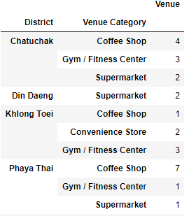

Applying Venues Requirements
Using .loc to filter the previous table with the venues and distance requirements and summarize the result table by grouping the district by count of venues.
From the table, the following districts have at least a gym within 2km, supermarket within 2km, and coffee shop within 1km:
Chatuchak
Khlong Toei
Phaya Thai
The analysis has narrowed down 50 districts in Bangkok to three that are similar to my neighborhood and has all the required venues within a specific distance. Thus saving me a significant amount of time to do a research and allowing me to focus for house hunting in smaller number of areas!

Slide 9
Conclusion
Built an analysis model to search for neighborhoods in Bangkok that share similarity to my current neighborhood (Edgbaston, Birmingham, UK) based on venues within a set radius. A set of required venues within a specific distance was also created to fulfill my required lifestyle.
The model resulted in three districts that matched my neighborhood out of 50.
The model is crude as it only looks to match neighborhood based on venues in the nearby area only. One would need more insights in the neighborhood than just types of venues. Additional data such as house prices, crime rate, proximity to public transport, etc. could be added as part of the analysis to search for a suitable neighborhood.

